Slide 1








Solomon Islands
Rodrick Kidoe
PCRN MEETING 2017 – CRVS for Disasters

Slide 2
Overview
Birth Registration is estimated to be: 42% complete – within 1 year of birth
28% of the total population is estimated to have had their birth registered
Birth certificates are provided for all new births except the National Referral Hospital births in Honiara as parents are encouraged to collect their child’s certificate at the CR office.
Death Registration is estimated to be: 12% complete – within 1 year of death
Cause of death (from a medical certificate) is provided for 50% of all deaths

Slide 3
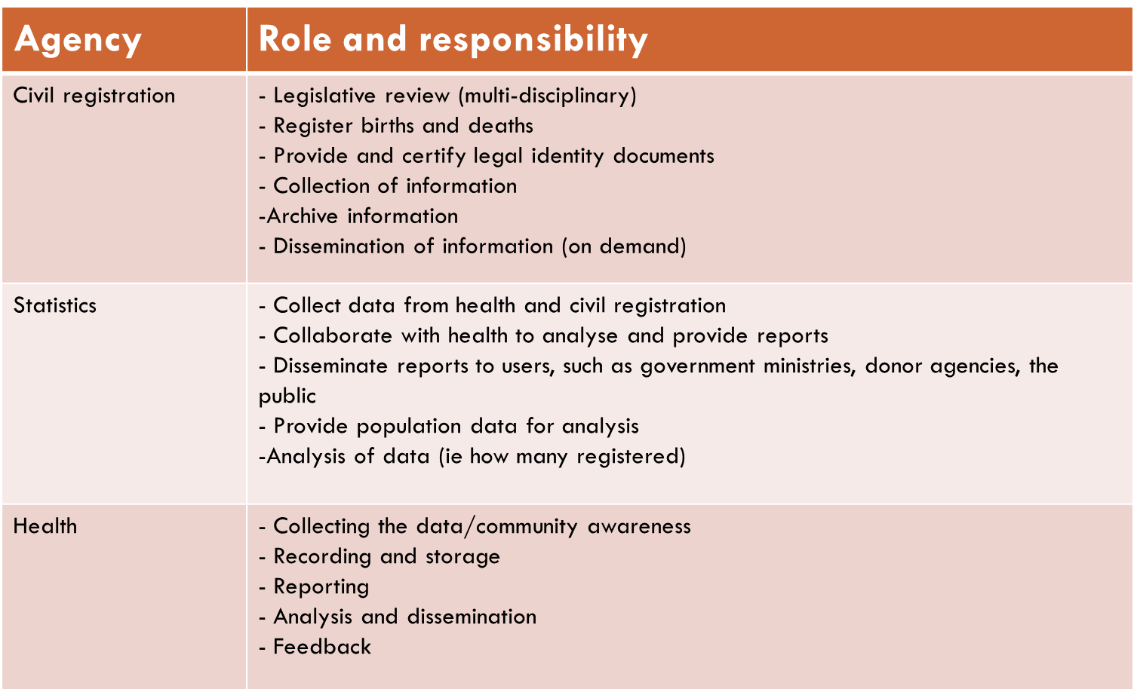
committee or coordination mechanism
SI National CRVS Committee
Registrar
Undersecretary - MHA
Chief Govt. Statistician
Principal Statistician
Undersecretary
Chief Medical Statistician
Other Members
Deputy Director – ICTSU
UNICEF - Child Protection Specialist & National Child Protection Officer
Bloomberg – Country Coordinator
WHO – HIS Technical Advisor
SPC - SI Coordinator

Slide 4
Targets/Goals
1. Coverage and quality of birth and death registration is increased
Phased expansion of civil registration services to provinces
Raise public awareness through information and education campaigns
Late and delayed registration program and developing a strategy for a nationwide registration drive
2. Institutional capacity of the CRVS system is strengthened
Develop the system design and standard processes
Strengthen the legislative and policy framework
Develop human resources and the organizational structure
Coordinate stakeholders and integrate CRVS improvement into other national development initiatives
Improve the accessibility and back office functioning of CRO
3. Registration data is utilized to produce vital statistics
Roll out a standard medical causes of death form for use in all hospitals
Pilot verbal autopsy for deaths that occur outside of health facilities
Use registration data to analyze and publish vital statistics

Slide 5


DATA storage and Protection
Where CR data are stored centrally hosted by SIG ICT mainframe.
How records are stored – Both Electronic and paper records
Data are backed up - Snapshots are backed up every four (4) hours daily – off site backup at the NDMO - Data Recovery Site (DR Site)
Different levels security and CR data are protected
local duplicate of the hard drive done by SIG ICT,
Copies of paper records done and stored with Civil Registration office.

Slide 6
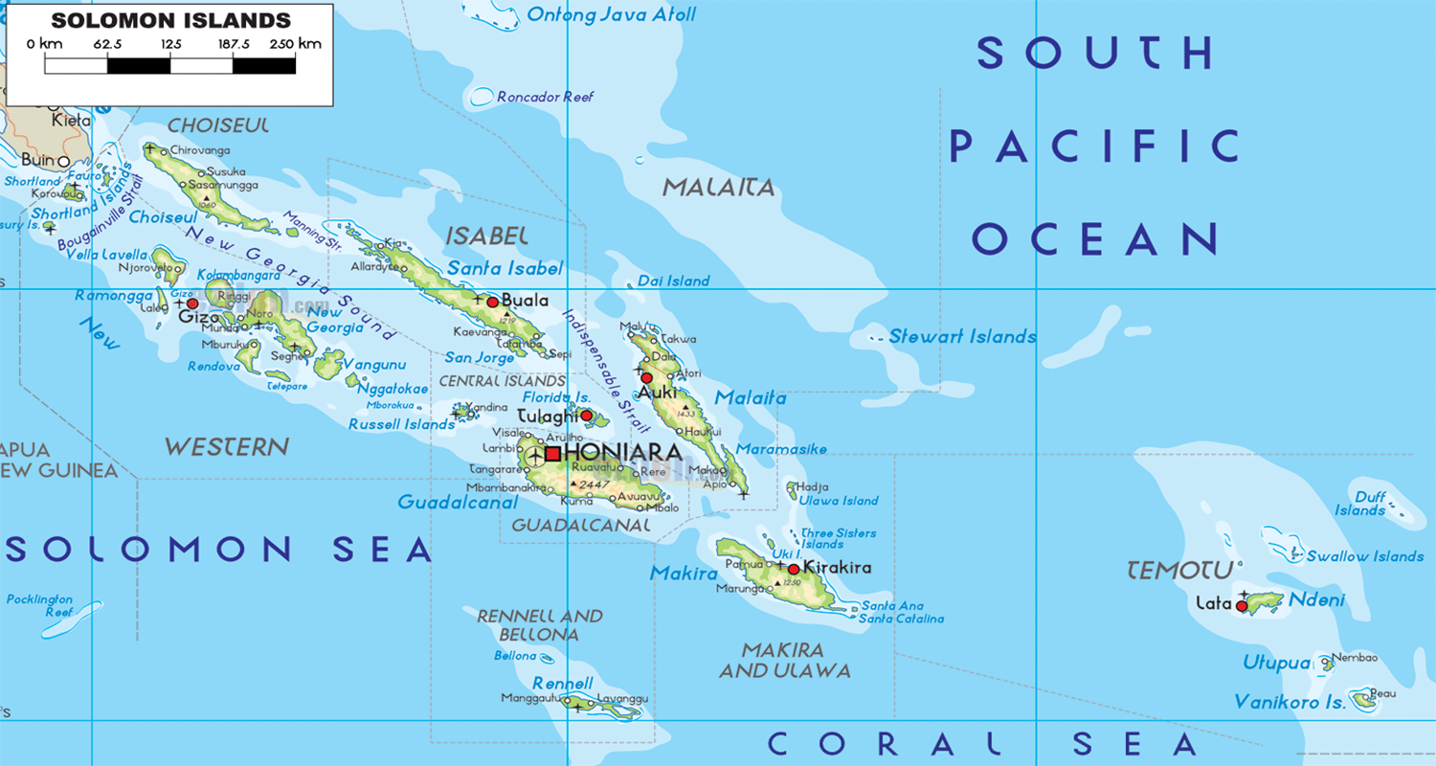

Major challenges FOR CRVS
(pre and post Disaster)
2 key challenges that you have identified as priorities in your system planning.
1. Bare minimum Legal framework with very weak enforcement.
Absence of a policy to guide administrative organization and structure, inter-ministerial collaboration, coordination and strategies to improve and strengthen CRVS.
Births and deaths data rarely generated, published and used by policymakers and public.
Data quality, integrity need vast improvement
Huge number of late and delayed registrations.
Need for collaboration and sharing in information management.
2. Geography, topography, lack of adequate infrastructure and a very rural based population.
Access information and services
Huge number of late and delayed registrations.
Lack of information and awareness on the importance and value of civil registration and vital statistics.
Tracking deaths in a disaster is even more critical & access to registry services may be harder than normal

Slide 7
disaster scale up
What do you see as the major challenges in your country to providing registration following a disaster.
Information are not organized or coordinated, there are challenges in accessing these information
Information and data are stored in many different locations and users need to obtain certain authorization
No proper coordination among different sectors and organizations
In most cases, information was not shared across committees/limited collaboration

