Slide 1
Historical Development of Laws on Family Relationship
Registration and Resident Registration in Korea
Dr. Hyung-Gun Kim
Office of Global Legal Research
Korea Legislation Research Institute

Slide 2
Contents
Ⅰ
Overview of Laws on Family Relationship Registration and
Resident Registration
Ⅱ
Historical Development Laws on Family Relationship Registration
and Resident Registration
Ⅲ
Concluding Observations

Slide 3
I. Overview of Laws on Family Relationship Registration and Resident Registration
1. Act on the Registration, etc. of Family Relationships
General Information
Family Resister Act (enacted on January 1, 1960 and amended 16 times) was constitutionally challenged on the grounds of gender discrimination and the Constitutional Court held unconstitutional in 2005
Family Register Act was replaced by Act on the Registration, etc. of Family Relationships (enacted on May 17, 2007 as Act No. 8435) in accordance with the abolition of the patriarchal family system
Act on the Registration, etc. of Family Relationships establishes the Family Relations Register according to the standard registered place by each individual and issues individual certificates such as Basic Certificate, Marriage Certificate and Family Certificate, abolishing the existing Family Register with the head of household and family status information
Current Act on the Registration, etc. of Family Relationships is divided into 8 Chapters and 13 Sections and is composed of 129 Articles (amended 15 times)
Purpose
The purpose of this Act is to prescribe matters concerning the registration of establishment of and changes in family relations such as the birth, marriage, death, etc. of people and other matters concerning certification thereof
4

Slide 4
I. Overview of Laws on Family Relationship Registration and Resident Registration
2. Resident Registration Act
General Information
According to the Joseon Dynasty Regulations on the Temporary Resident Register (enacted on September 26, 1942), those who have chosen a place of residence, different from the permanent residence, to stay longer than 90 days in such place, are required to register the Temporary Resident Register
Act on the Temporary Resident Register was enacted as Act No. 967 when Korea gained independence from Japan → When a place of residence is different from the permanent residence, it is subject to reporting and can also be registered in the Register
Resident Registration Act was enacted on May 10, 1962 as Act No. 1067, replacing Act on the Temporary Resident Register
Current Resident Registration Act is composed of 40 Articles (amended 32 times)
Purpose
The purpose of the Act is to promote the convenience of residents’ livelihoods and to properly process administrative affairs by clearly ascertaining the residential status of residents and the movement of the population through the registration of residents residing in each Si, Gun or Gu
3

Slide 5
II. 1. Historical Development – Major Amendments to Act on the Registrations, etc. of Family Relationships (1)
Enactment by Act No. 8435 (2007.5.17)
Enacted to establish the new registration system of family relationships, replacing the existing Family Register with the head of household and family status information and recording any change of status such as birth, marriage, and death of individual citizens through a computerized information processing system
Major Provisions Inserted or Amended
Made central Governments in charge of family relationships related registration affairs
Reformed the Family Relations Register for individuals and allowed management through a computerized information processing system
Clarified the issuance of different types of certificates by purpose and the criteria of application for the issuance
15

Slide 6
II. 1. Historical Development – Major Amendments to Act on the Registrations, etc. of Family Relationships (2)
Amendment by Act No. 9832 (2009.12.29)
Amended to protect the privacy of an adoptive family by changing the existing certificate of the Family Relationships Register which discloses the biological parents as well as adoptive parents
Major Provisions Inserted or Amended
With this amendment, a certificate of the Family Relationships Register discloses only adoptive parents as parents, and the certificate of Adoption Relations discloses both biological parents and adoptive parents only when requested by an applicant
16

Slide 7
II. 1. Historical Development – Major Amendments to Act on the Registrations, etc. of Family Relationships (3)
Amendment by Act No. 11950 (2013.7.30)
Amended to establish legal grounds for the issuance of certificates via the Internet and unmanned machines and legal grounds for criminal background checks for a person who has acquired the Korean nationality
Major Provisions Inserted or Amended
Provided legal grounds for the issuance of certificates processed through the Internet and unmanned certificate issuing machines
Established the electronic reporting system employing a computerized information process system
Provided legal grounds for criminal background checks on the establishment of a new surname and place of family origin for a person who has acquired the Korean nationality
17

Slide 8
II. 1. Historical Development – Major Amendments to Act on the Registrations, etc. of Family Relationships (4)
Amendment by Act No. 12878 (2014.12.30)
Amended to provide for legal grounds for the registration of death caused by disasters, etc. and death of a person with no relatives or interested persons
Major Provisions Inserted or Amended
Gave the Head of Si/Eup/Myeon the power to register the death caused by disasters, etc. and the death of a person with no relatives or interested persons ex officio
18

Slide 9
II. 1. Historical Development – Major Amendments to Act on the Registrations, etc. of Family Relationships (5)
Amendment by Act No. 13285 (2015.5.18)
Amended to secure the right to life of an abandoned out-of-wedlock child by allowing the biological father to register a birth on with confirmation of the family court
Major Provisions Inserted or Amended
Enabled the biological father of an abandoned out-of-wedlock child to register a birth on behalf of the child with confirmation of the family court, repealing the existing provisions of Act on the Registrations, etc. of Family Relationships that require either a biological mother or blood relatives of the biological mother, etc. to register a birth of an out-of-wedlock child
18

Slide 10
II. 1. Historical Development – Major Amendments to Act on the Registrations, etc. of Family Relationships (6)
Amendment by Act No. 14169 (2016.5.29)
Amended to prevent the disclosure of family relationships information through the issuance of an authentic certificate copy of the Family Relationships Register by allowing a civil petitioner to choose the information to be disclosed in the certificate of the Register
Major Provisions Inserted or Amended
Specified certain information to be disclosed in different types of certificates of the Family Relationships Register
19

Slide 11
II. 2. Historical Development – Major Amendments to Resident Registration Act (1)
Enactment by Act No. 1067 (1962.5.10)
Enacted to promote a proper and simplified process for administrative affairs by clearly ascertaining the residential status of residents and the movement of the population
Major Provisions
Made City Mayors or Head of Eup or Myeon in charge of managing administrative affairs related to resident registration
Required a person who has a place of residence to stay longer than 30 days to report for registration
Specified what information is to be registered in the Register
Required a registration to be done within 14 days from the date on which the event subject to registration occurs
Repealed Act on the Temporary Resident Register
5

Slide 12
II. 2. Historical Development – Major Amendments to Resident Registration Act (2)
Amendment by Act No. 2016 (1968.5.29)
Amended to secure the effectiveness of the resident registration system by issuing a person over 18 years old a resident registration card (National ID Card) and by adding military service records as a matter to be reported
Major Provisions Inserted or Amended
Gave City Mayors or Head of Eup or Myeon the power to require a person who has a place of residence to stay longer than 30 days to report for registration (excluding foreigners)
Added military service records and specialized skills to the matters to be reported
Introduced discretionary registration and objection or reexamination claims to such registration
Made a place of residence on the Register an official address under relevant public laws
Enabled issuing a person over 18 years old a resident registration card
6

Slide 13
II. 2. Historical Development – Major Amendments to Resident Registration Act (3)
Amendment by Act No. 2150 (1970.1.1)
Amended to promote administrative efficiency and convenience of residents by allowing government officials to use resident registration cards for administrative purposes and to facilitate hunting out spies and/or suspected subversives by requiring the presentation of a resident registration card
Major Provisions Inserted or Amended
Gave authorized government officials the power to verify a civil petitioner’s personal information by his/her resident registration card
Gave judicial police officers the power to request the presentation of a resident registration card when deemed necessary to verify the identification or residential information of a resident
7

Slide 14
II. 2. Historical Development – Major Amendments to Resident Registration Act (4)
Amendment by Act No. 3041 (1977.12.31)
Amended to promote administrative efficiency by consolidating residents’ personal information into an individual resident registration form and to further convenience of residents by simplifying reports related to the movement of residence under various laws
Major Provisions Inserted or Amended
Established an individual resident registration form
Replaced moving-in and moving-out reports under other laws (e.g., Military Service Act, Protection of Minimum Living Standards Act, Certification of Seal Imprint Act) by moving-in and moving-out reports under Resident Registration Act
Established a criminal monetary penalty or penal detention for not applying for the issuance of a resident registration card, without any justifiable reason, for more than 1 year from the date of notification
8

Slide 15
II. 2. Historical Development – Major Amendments to Resident Registration Act (5)
Amendment by Act No. 4314 (1991.1.14)
Amended to establish legal grounds for computational processing of administrative affairs related to resident registration and to resolve other management issues
Major Provisions Inserted or Amended
Allowed administrative affairs related to resident registration (e.g., writing, storage, transfer and management of resident registration forms, issuance of certificates) to be computationally processed
Set limits to the scope of persons accessing resident registration forms (i.e., reading and/or issuing an authentic copy of resident registration forms) to protect an individual’s private life and to prevent crimes
Established a penalty provision for a charge of revealing individuals’ information on resident registration
9

Slide 16
II. 2. Historical Development – Major Amendments to Resident Registration Act (6)
Amendment by Act No. 5459 (1997.12.17)
Amended to replace resident registration cards with electronic resident registration cards (chip-based resident registration cards) to prevent crimes caused by forging and/or falsifying the existing resident registration cards
Major Provisions Inserted or Amended
Replaced resident registration cards with electronic resident registration cards and authorized certain information under Certification of Seal Imprint Act to be recorded into the cards
Reduced a criminal monetary penalty or penal detention for not applying for the issuance of an electric resident registration card to an administrative fine
10

Slide 17
II. 2. Historical Development – Major Amendments to Resident Registration Act (7)
Amendment by Act No. 5987 (1999.7.21)
Amended to put the previous amendment back (i.e., the replacement of the existing resident registration cards with the new electronic resident registration cards) due to potential invasion of privacy and to change the materials of the resident registration cards for better protection from forging and/or falsifying the resident registration cards
Major Provisions Inserted or Amended
Replaced all issued resident registration cards with new plastic cards, instead of issuing new electronic resident registration cards
Removed information on the head of household and military service records from the information shown on the certificates for privacy concerns
11

Slide 18
II. 2. Historical Development – Major Amendments to Resident Registration Act (8)
Amendment by Act No. 6385 (2001.1.26)
Amended to allow an authentic copy of resident registration forms to be processed and issued by a unmanned machine on civil petitioners’ request and to establish more severe penalties for generating false resident identification (National ID) numbers and other crimes related to resident registration
Major Provisions Inserted or Amended
Allowed unmanned machine-based processing and issuing of an authentic copy of resident registration forms
Established legal grounds of assigning resident identification (National ID) numbers
Established penalties for generating false resident identification numbers and other crimes related to resident registration (less than 3 years of imprisonment and/or 10,000,000 won (approx. 9,000 US dollars) of criminal money penalties)
12

Slide 19
II. 2. Historical Development – Major Amendments to Resident Registration Act (9)
Amendment by Act No. 7201 (2004.3.22)
Amended to establish an electronic information backup system for resident registration in preparation for natural disasters and accidents and to promote the convenience of residents by establishing an electronic application system for reading and/or issuing an authentic copy of resident registration forms, modifying resident registration information, claiming an opposition to the annulment of registration, etc.
Major Provisions Inserted or Amended
Enabled civil petitioners to electronically apply for the reading and/or issuing an authentic copy of resident registration forms, modifying resident registration information, claiming an opposition to the annulment of registration, etc.
Established the Electronic Information Center for Resident Registration and the duty to make an electronic information backup system for resident registration in preparation for natural disasters and accidents
13

Slide 20
II. 2. Historical Development – Major Amendments to Resident Registration Act (10~12)
Amendment by Act No. 10733 (2011.5.30)
Amended to promote convenience of the disabled by resolving difficulties in using the resident registration card (i.e., the issuance of a Braille registration card to the blind) and by requiring the relevant public officials to visit the severely disabled for the issuance or reissuance of their resident registration cards)
Amendment by Act No. 12279 (2014.1.21)
Amended to introduce the new resident registration card issuance system dedicated exclusively to overseas Koreans, repealing the resident registration annulment of the overseas Koreans
Amendment by Act No. 14191 (2016.5.29)
Amended to introduce the resident registration number changing system allowing civil petitioners to change their resident registration numbers (when the resident registration numbers are leaked and such leakage can cause damage to their life, body or property) subject to a decision by the Committee established in the Ministry of Government Administration and Home Affairs
14

Slide 21
III. Concluding Observations (1)
Act on the Registration, etc. of Family Relationships
Prescribing matters concerning the Family
Register (1960~)
Based on the patriarchal family system
The family register revealing the head of household and family status information
Prescribing matters concerning the registration
of establishment of and changes in family
relations such as the birth, marriage, death, etc.
of people and other matters concerning
certification thereof (2007~)
Introducing the individual-based registration system and the issuance of an individual certificate by purpose
Allowing a person to choose family relationships information to be dislosed in a certificate
21

Slide 22
III. Concluding Observations (2)
Resident Registration Act
Promoting proper and simplified process
for administrative affairs (1962~)
Securing the effectiveness of the resident registration system
Promoting administrative efficiency
Establishing legal grounds for computational processing of administrative affairs
Promoting convenience of residents’
livelihoods (1998~)
Introducing unmanned machines processing and issuing an authentic copy of the resident registration form
Establishing an electronic application system for reading, issuing and/or modifying resident registration information
Establishing more severe penalties for crimes related to resident registration
Promoting convenience of the disabled and overseas Koreans
Introducing the resident registration number changing system
20

Slide 23
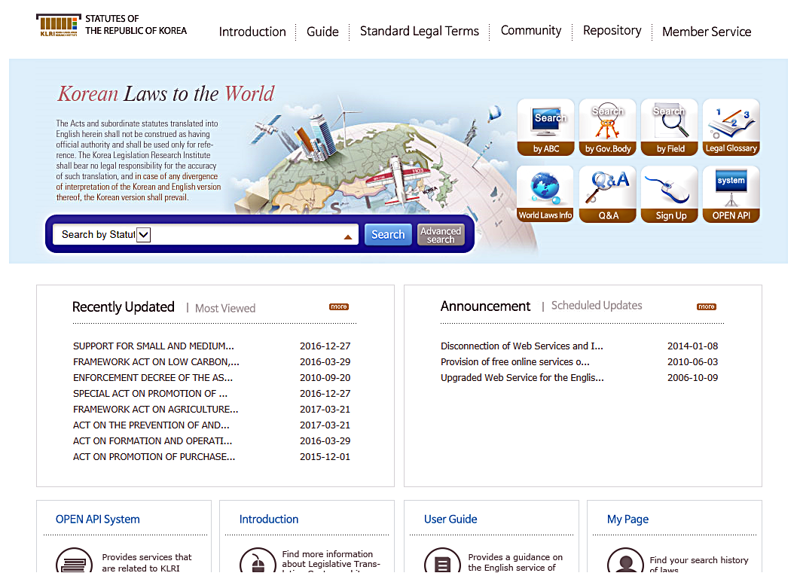
Source of Korean Laws(English Translation):
http://elaw.klri.re.kr/eng_service/main.do
22

Slide 24
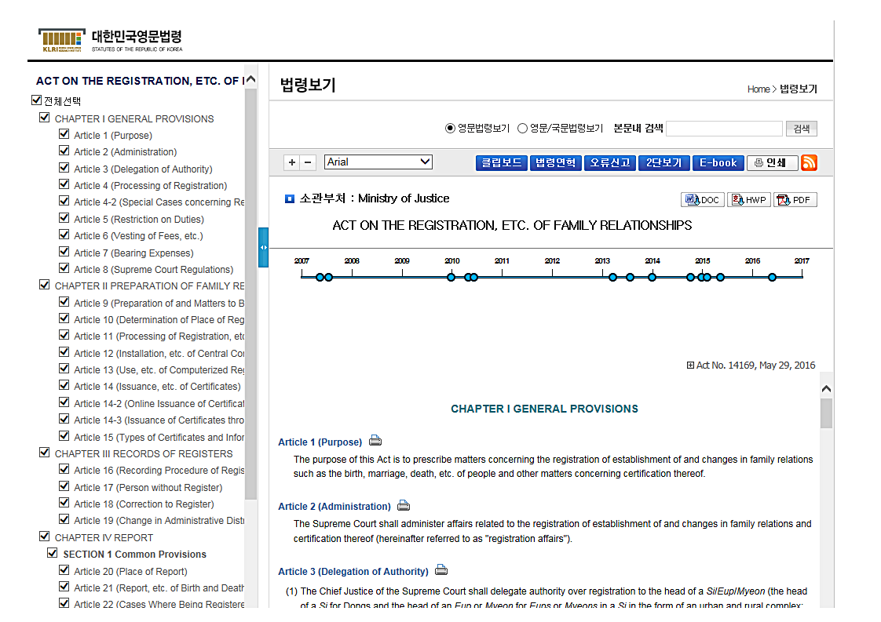
Source of Korean Laws(English Translation):
http://elaw.klri.re.kr/eng_service/main.do
23

Slide 25
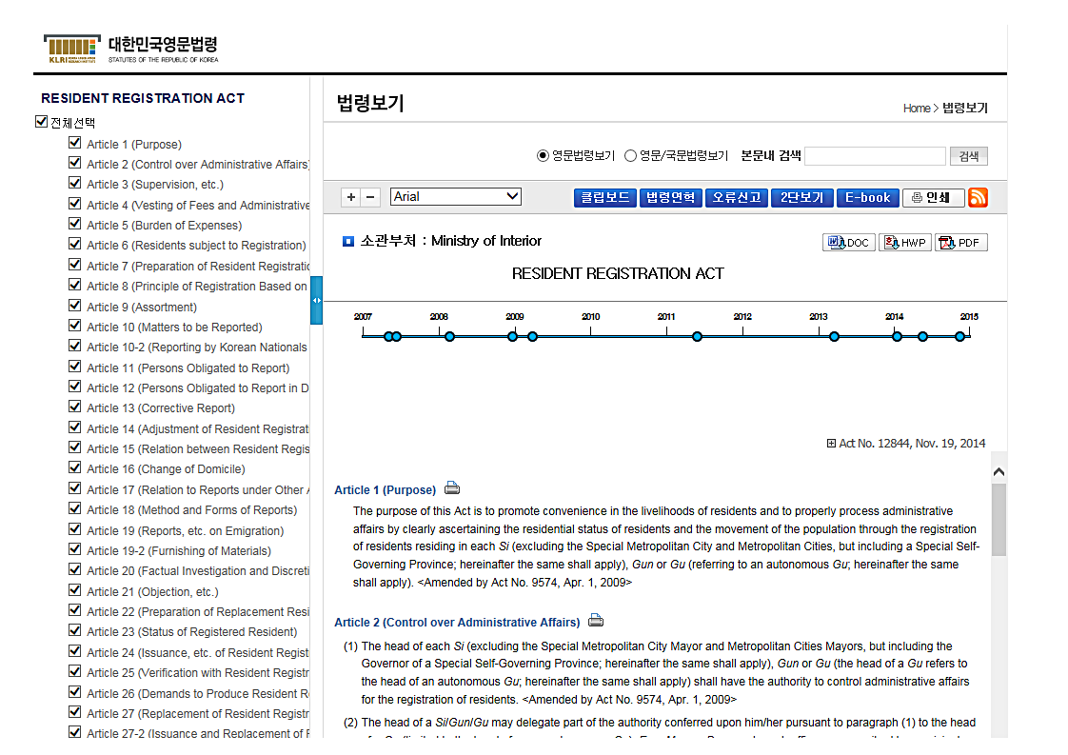
Source of Korean Laws(English Translation):
http://elaw.klri.re.kr/eng_service/main.do
24

Slide 26
Thank You!!
Korea Legislation Research Institute

