Slide 1


Cambodian National ID
Program
General Department of Identification (GDI)
Ministry of Interior
Kingdom of Cambodia
Notes:
Good afternoon Ladies and Gentlemen !
It is my great pleasure to be here with all of you today in a beautiful city Nay Pyi Taw.
I also thank to the Center of Humanitarian Dialogue that inviting me and my colleague to joint this important workshop.
I also thank to Ministry of Labor, Immigration and Population that allowing Cambodia to share with you the our lesson learnt so far on the issues of ID Card initiative.

Slide 2
Contents
Background
Our Organization
Long Term Vision
Implementation plan
Charlenges
Notes:
In my presentation, I will show to you about our Background, Our Organization, about Khmer eID Card, our Long Term Vision, and last but not less is about Lesson Learnt.

Slide 3
Background
Before establishment of GDI, some departments managed by different General Departments:
  Passport, Khmer ID & Statistic was an office of Passport & Statistic Department under the General Police Commissioner
  Civil Registration was an office under General Department of Local Administration
Each department focused on their own duties.
Notes:
About our Background:
My organization, General Department of Identification is a New Institution that has just established on 1 Apr 2014 under the Ministry of Interior, in order to rounds up and governs its own fragmented public services under an exclusive management of a specific institution.
Before the establishment of the General Department of Identification, Civil Registration and Nationality works were under the management of the General Department of Local Administration, while Residential Registration, Khmer ID Card and Normal Passport works were under the management of General Commissariat of National Police.
In addition, Civil Registration work was under the responsibility of the an office of Civil Registration but in fact it should be under the responsibility of higher institution because it is the fundamental information to create legal identity of individual and providing the basic data to other sectors.

Slide 4
Our Organization
  1- Department of Civil Registration
  2- Department of People Statistic
  3- Department of Khmer ID Card
  4- Department of Passport
  5- Department of Nationality
  6- Department of Administration
  7- Department of Management Information System
Notes:
About Our Organization:
GDI have 7 departments:
1- Department of Civil Registration
2- Department of People Statistic
3- Department of Khmer ID Card
4- Department of Passport
5- Department of Nationality
6- Department of Administration
7- Department of Management Information System

Slide 5
Our Organization
Scope of works:
Mandated to manage all identities issues of all population of Kingdom of Cambodia
Supervise to administration services of identities works providing by local authorities
Provide some administration services of identities works at national level by Issueing Khmer ID Card and Passport and other travel documents
Manage CRVS and Residential System
Ensure single soure of truth of all individual and population
Provide legal advices to sub-national level on identities issues etc.
Notes:
And our mandate are:
- to manage all identities issues of all population of Cambodia
- to supervise the administration services of identities works providing by local authorities
- to provide some administration services of identities works at national level such as Issueing Khmer ID Card and Passport and other travel documents
- to manage CRVS and Residential System
- to ensure single soure of truth of all individual and population and
- to provide legal advices to sub-national level on identities issues etc.

Slide 6
Long Term Vision
National Strategic Plan for Identification (NSPI 2017-2026)
Everyone is identified
Devlop an enabling legal environment for personal identification
Establish Universal and Responsive CRVS system
Establish an Integrated Population Identification System (IPIS) that will ensure a single reliable source of information about individuals and population and assign the personal Khmer Identification Code (KIdC) at the moment of registering birth and will carry this code throughout life
Launch unifies data distribution system about population
Align organization and introduce E-Services for client-oriented, efficient and transparent service delivery
Notes:
About our Long Term Vision:
Cambodia is deeply committed to achieving targets set out by the Sustainable Development Goals. And Cambodia is also striving to fully integrate the country into the ASEAN economic community and to benefit from this.
For this to happen reforms in many areas must be continued and some new ones need to be launched. One of such reform is building a modern identification system in Cambodia, which would ensure that the country benefits from information on population and vital statistics, and uses them for strategic planning purposes at the national and local levels, thus improving results by reaching those who are neediest. The identification system will improve the efficiency and effectiveness of programs and resources used, support regional economic and financial integration, and provide reliable statistics to Cambodia’s partners and the global community.
Therefore, this National Strategic Plan is aiming to achieve a long-term vision for Cambodia — every person is to have an identity. This will require to:
Develop an enabling legal environment for personal identification. Cambodia’s current legislation is deemed insufficient as the basis for a modern, computerized civil registration, identification and vital statistics system. The Government recognizes the urgent need for comprehensive reform of the legislation on civil registration, identification and vital statistics. It need 3 steps to go are (1).Drafting a completely new law on civil registration, identification and vital statistics; (2).Drafting sub-decrees; and (3).Amended provisions in the legal framework envisaging interfacing interaction between the CRVS system and the IPIS and its operation.
To build a modern, permanent, universal civil registration system (CRVS) that will generate reliable vital statistics that reflects the resolution adopted by the Economic and Social Commission for Asia and the Pacific in 2014. A universal and responsive CRVS system should be developed and supported by Web-enabled and nationally harmonized registration processes at the Commune/Sangkat level.
To build an integrated population identification system (IPIS) that will ensure that the country has a single reliable source of information about individuals and population. The Integrated Population Identification System shall be established to serve as an integration platform for other institutions and their systems as the primary and single data source on population information.
Launch unifies data distribution system about population: It aims at gaining efficiency to aggregate the information disclosure function from all subsystems of the IPIS to one central unified data distribution center. The data distribution system shall cover the database that receives replicated data on the population of Kingdom of Cambodia from the Population Registry and makes this data available for quick searching or verification of identity as well as reporting services.
Align organization and introduce E-Service for Client-oriented efficient and transparent service delivery: all services related to registration and identification should be available at convenient locations that are easily accessible by the population, and these services should follow a high standard of implementation. Cambodia is also seizing the possibility to implement e-governance by using ICT technology for the provision of services to the population. Therefore, civil registration, the issuance of identity documents and other services need to be brought online.

Slide 7
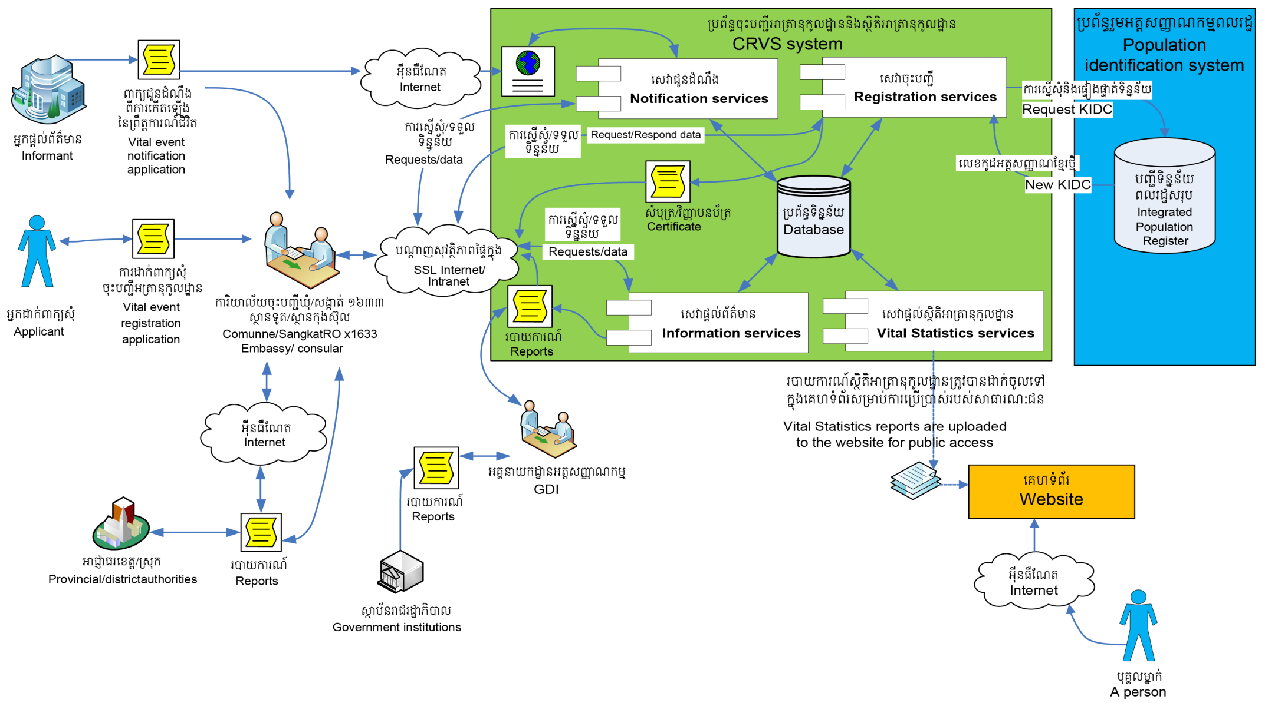
Long Term Vision
National Strategic Plan for Identification (NSPI 2017-2026)
Conceptual Design of CRVS
Notes:
The conceptual design of CRVS system is composed of at least 4 major services:
1. Notification Service : that handle notifications from the authority that witnessed the appearance of the vital event. This notification will enter and store in CRVS system until applicants arrive with the original copy and request registration of vital event.
2. Registration Services : these service handle the collection of the application dossier to register the vital event. They also handle data entry and the uploading the scanned annexes as well as data verification process, registration approval process and issuance registration certificate. Via the internet all registration offices connect to the CRVS and perform registration. A KidC is assigned upon the approval of an application to register birth event.
3. Information Services : these services handle request for information by public users via CRVS information services. Request are accepted manually (on paper) or online. The CRVS will have the possibility to notify appropriate institutions about vital events upon a signed agreement of cooperation. Notification could be performed through defined notification channels.
4. Vital Statistic Services: these services handle the generation of information according to the vital statistic tabulation plan, which is later published online for public access.
The CRVS system should be integrated with the Population Identification System on a system-to-system basic, according to the specification developed and provided together with the Population Identification System.

Slide 8
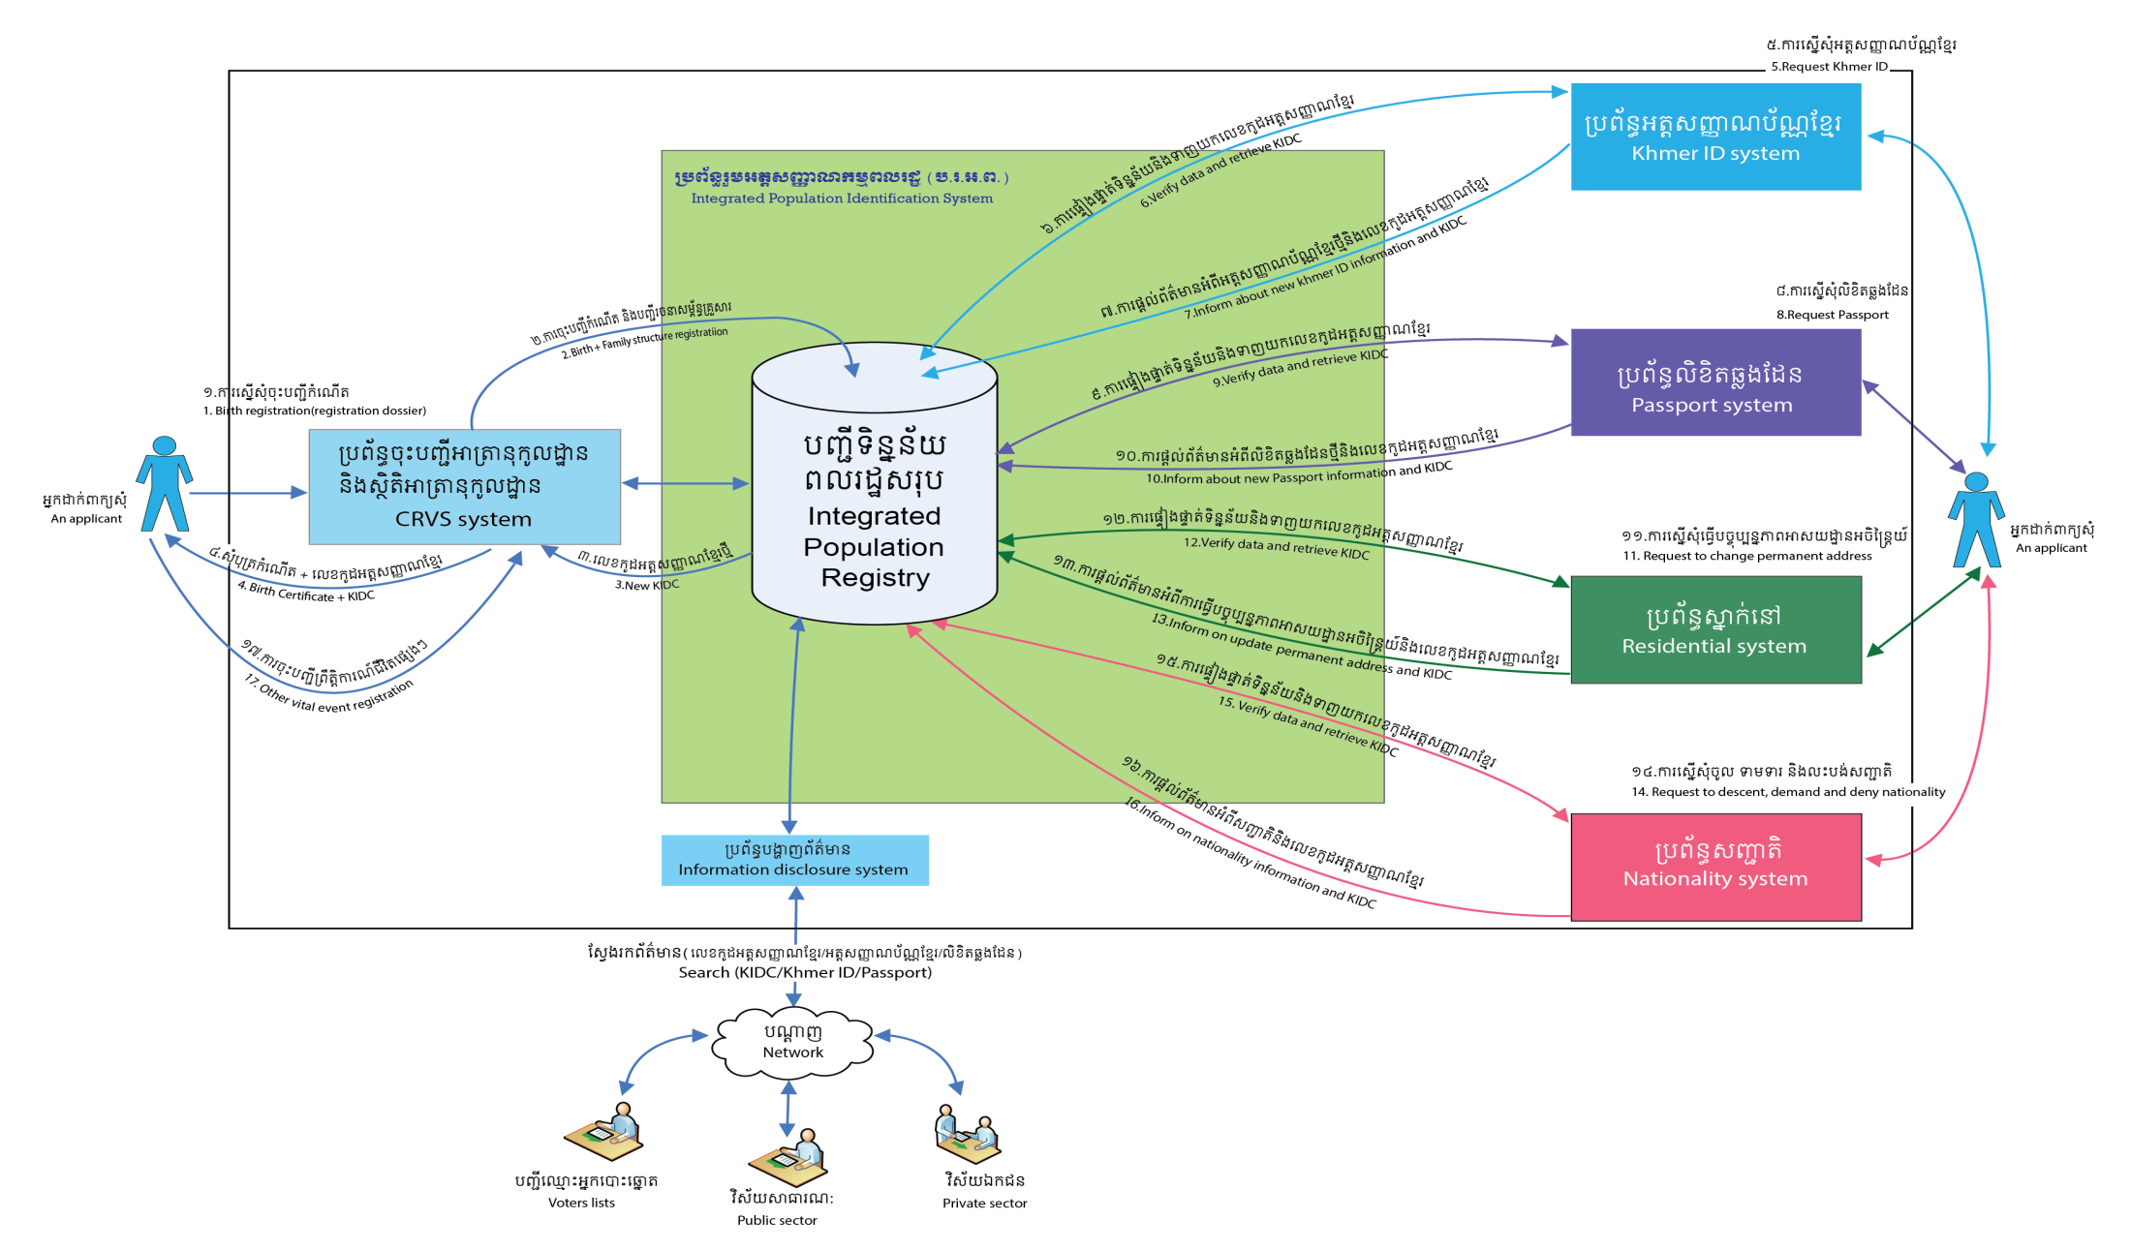
Long Term Vision
National Strategic Plan for Identification (NSPI 2017-2026)
Integrated Population Identification System - IPIS
Notes:
This is the conceptual design for IPIS:
This design will guide us to have reliable nationwide information on the population as well as unique identification for every person of Cambodia. Data in Population Registry is to be constantly updated (preferably in real time) from other systems.
Existing and emerging computerized systems related to identification need to be integrated to the Population Identification System (IPIS) on a system-to-system basis in order to be able to search for actual and correct information on individuals such as:
- Civil Registration and Vital Statistics System
- Khmer ID Card Management System
- Passport Management System
- Residential Management System
- Nationality System
The conceptual design of the IPIS integrates all systems involved in the continuous recording of information pertaining to each member of the resident population of a country, making it possible to determine up-to-date information about the size and characteristics of the population at selected points in time. The CRVS acts as the initial registration point, where a new record for an individual is created in the Population Identification System and a new Khmer Identification Code (KIDC) is generated and assigned to it.
IPIS will enable different institutions to share the same information about the individuals, and to search and contribute to the updating information on individuals. The IPIS should ensure secure information disclosure to the authorized recipients of information and therefore should integrate with the information distribution system.

Slide 9

Long Term Vision
National Strategic Plan for Identification (NSPI 2017-2026)
Introducing Khmer Identification Code - KIDC
Kid Code : 123456789-Y
123456789  9 digits is random
Y  Checksum
Notes:
The Khmer Identification Code (KIDC) will be generated exclusively by the Population Identification System (IPIS) and will be provided to each person in the IPIS. The length of the number shall be ten digits in total, constructed from one reserved digit, eight random digits, plus one checksum digit that is based on the Modulus 11 algorithm. A reserved digit will be used to distinguish foreigners temporarily living and working in the country from citizens of Cambodia.

Slide 10
Implementation Plan of NSPI
Under technical support by ADB, consultants from Ernst & Young help GDI to develop comprehensive Implementation Plan fo NSPI in 2016.
One of the main components of the implementation plan is “To develop enabling legal framworks for CRVS and Identification”.
We are planning to draft an integrated law on CRVS and Identification Management System then draft other related Sub-Decrees and Regulations to implement this new law.
Main points need to put in the new law are:
  Guarantee integrate platform for CRVS, ID management and eco-system;
  Gorvern population database at national level;

Slide 11
Implementation Plan of NSPI (cont.)
Main points need to put in the new law are: (cont.)
  Using ICT solution CRVS, Resident Registration System, issuance ID Card, issuance Passport;
  Inroduce KIDC;
  Protrocol of using personal data and personal privacy protection;
  Linkage with other sectors for authentication services;
The implemenation plan is starting to implement, so we are looking at two aspects: legal framework and technical deirection.
If legal framework development take time, it should start up with technical direction.

Slide 12
Charlenges
Sub-Decree on civil registration enacted in 2002 and some point is not comply with international regulations that Cambodia had ratified.
Sub-Decree on residential registration enacted in 1997 and no any reviewed or updated.
Sub-Decree on ID Card enacted in 2007 and not so much changes.
Civil registration system and residential registration system is doing by hand. All records write into the books and keep at local authorities.
All legislations relating to civil registration and identification stay separated and not concurrent to each other.
No Law on CRVS and ID Management System.
Legal framework developing need time.

Slide 13
Thank You !
Notes:
Ladies and Gentlmen
I finish my presentation here and welcome for commends, suggestions and question.
Thank you.

