Slide 1

Strategies to improve coverage and accuracy of CRVS systems in Indonesia
Mariet Tetty Nuyetty
13-17 November 2017
Hanoi – Vietnam

Slide 2
Outline
Current CRVS facts in Indonesia
Laws and Regulations relating to CRVS
Changes in Indonesia’s CRVS
Obstacles for complete coverage and improving accuracy
Obstacles for compiling vital statistics based on civil registration data
Efforts for assessing the quality of CRVS systems
Measures to improve quality and interoperability of CRVS

Slide 3
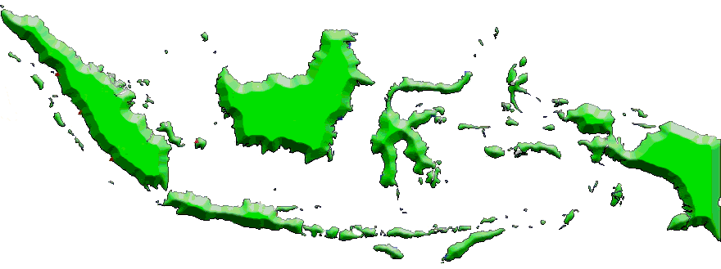
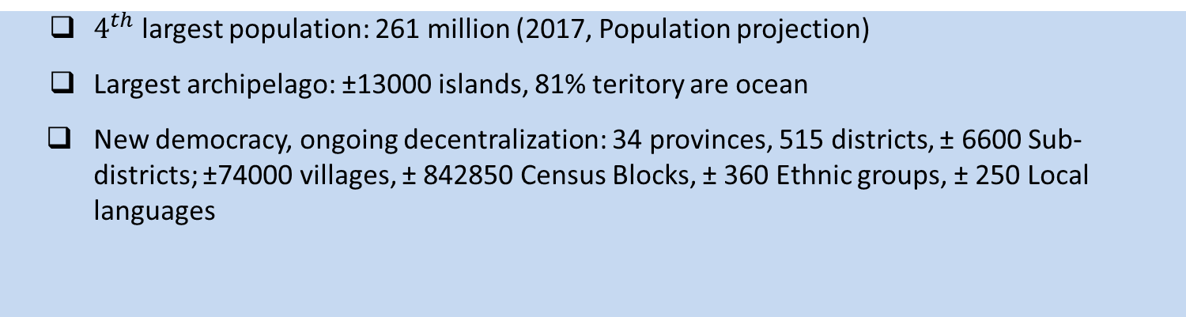
Indonesia

Slide 4
Current CRVS Facts in Indonesia
83,15% children (0-4) have birth certificate, 17,85% did not have yet (2015 Intercensal Population Survey). In 2016, 62% from the poorest families, 66% living in rural areas (Naational Socio Economic Survey 2016)
55% marriages amongst the poorest unregistered, 75% of their children didn’t have a BC (AIPJ-PUSKAPA-PEKKA, 2013). Marriage registration process are split into two institutions, MoRA for Islam marriage and MoHA for all non-Islam marriage. All marriage registration require a letter from official religious marriage.
2% divorcees had a divorce certificate (KOMPAK-PUSKAPA, 2015). Divorce process are split into two institutions, Religious Court for Islam marriage and State Court for all non-Islam marriage.
Death registration. No official coverage data (“10.27%”, Ministry of Home Affairs: SIAK 2016) | 84% deaths took place at home, 2% of them registered the event (KOMPAK-PUSKAPA, 2015)

Slide 5
Laws and Regulations relating to CRVS
Children’s Rights
Indonesia Constitution (UUD 1945)
Human Rights Law (UU 39/1999)
Child Protection Law (UU 23/2002).
These laws provide provisions on the rights of the child, including children’s rights to have citizenship and a name as part of identity from birth, right to know their origin, and right to have a birth certificate.

Slide 6
Laws and Regulations relating to CRVS (2)
Civil Registration System
Population Administration Law (UU 23/2006 & 24/2013)
Government Regulation (PP) 37/2007
Presidential Regulation (Perpres) 25/2008
Minister of Home Affairs Regulation (Permendagri) 9/2016 Indonesia Constitution (UUD 1945)
UU 23/2006 frames Indonesia’s civil registration system and population administration establishes the requirements and process to obtain birth and death certificates as well as the certification of other vital events.
UU 24/2013 overruled several provisions from UU 23/2006. One of the changes was to simplify the procedure for late birth registration in accordance with Constitutional Court Decision Number 18/PUU-XI/2013. PP 37/2007 and Perpres 25/2008 provide technical guidance for UU 23/2006.

Slide 7
Laws and Regulations relating to CRVS (3)
Standard of Services
Public Service Law (UU 25/2009)
Government Regulation (PP) 96/2012
UU 25/2009 establishes performance standards for government agencies providing services. According to PP 96/2012, administrative services generate various forms of official documents, which are essential for the protection of citizens.

Slide 8
Laws and Regulations relating to CRVS (4)
Decentralization
Local Government Law (UU 23/2014 & 9/2015)
According to this law, local governments are required to provide civil registration services and can establish their own regulations to improve civil registration services.
Village Law (UU 6/2014)
This law provides authority for villages to lead their own development planning, budgeting, and programming.

Slide 9
Changes in Indonesia’s CRVS
In 2015, Minister for Home Affairs issued a Directive16 to all provincial governors and city mayors highlighting the Medium Term Development Plan targets and identified two priorities for civil registry officials: firstly, there now needs to be a focus on issuing birth certificates within 60 days for new-born babies, and, second, all old records of birth certificates contained in hard-copy register books must be re-entered into the MoHA population administration database (known by its acronym SIAK) so as to ensure Indonesia has more up-to-date data on children with and without birth certificates. The Minister also sought data on how many of the children already included in the population administration database have birth certificates.
The Minister for Home Affairs and the Ministers for Foreign Affairs, Law and Human Rights, Health, Education and Culture, Social Affairs, Religious Affairs and Women’s Empowerment and Child Protection sign a Memorandum of Understanding (MOU).
This MoU aims to create synergies between the roles and programs of the eight Ministries in order to increase the pace of obtaining birth certificates for Indonesian child within and outside its borders.
In 2016, Minister for Home Affairs issued a Ministerial Regulation (Number 2 of 2016), covering the Child ID Card. The aim is to protect and fulfill the constitutional rights of citizens. In order to obtain a child ID card the parents must produce the child’s birth certificate and the family and ID cards of the parents or guardians.

Slide 10
Changes in Indonesia’s CRVS (2)
Minister for Home Affairs issues a Circular to all Provincial Governors and City Mayors and requests them to accelerate services for the recording and the publication of electronic ID cards and birth certificates.
The Minister commences by indicating that at present only 86% of the population has an e-ID card and 61.6% a birth certificate. The Minister asks Heads of civil registration and population offices to collaborate with the Heads of Education, Health and Hospitals in the regions to actively take birth certificate services to schools (kindergarten, primary and secondary schools, vocational schools as well as hospitals, health and birth centres). Local governments are also banned from imposing additional requirements in relation to the recording and the publication of electronic ID cards and birth certificates, for example, levying taxes or requiring a letter from the police or other requirements. Director General of the Religious Courts of Indonesia issues a Circular to all Religious Courts clarifying procedures for marriage legalisation case fees and costs of implementing integrated and mobile services together with officials from the Ministries of Religion and Home Affairs.

Slide 11
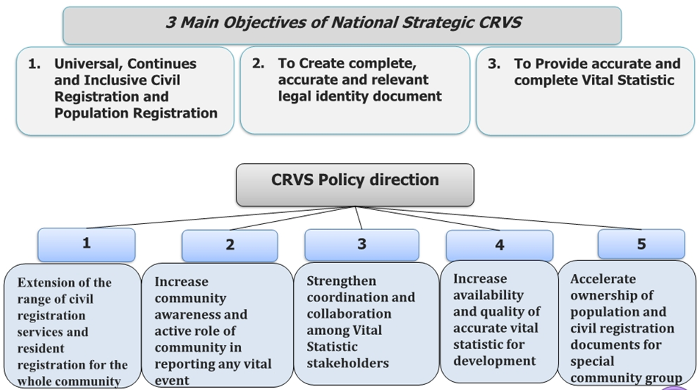
CRVS National Strategic Plan

Slide 12
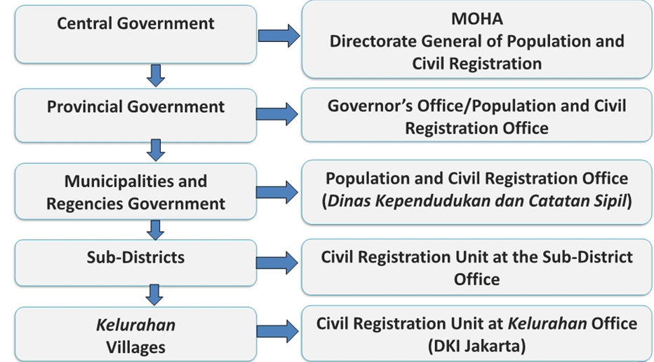
The Structure of Population Administration Management

Slide 13
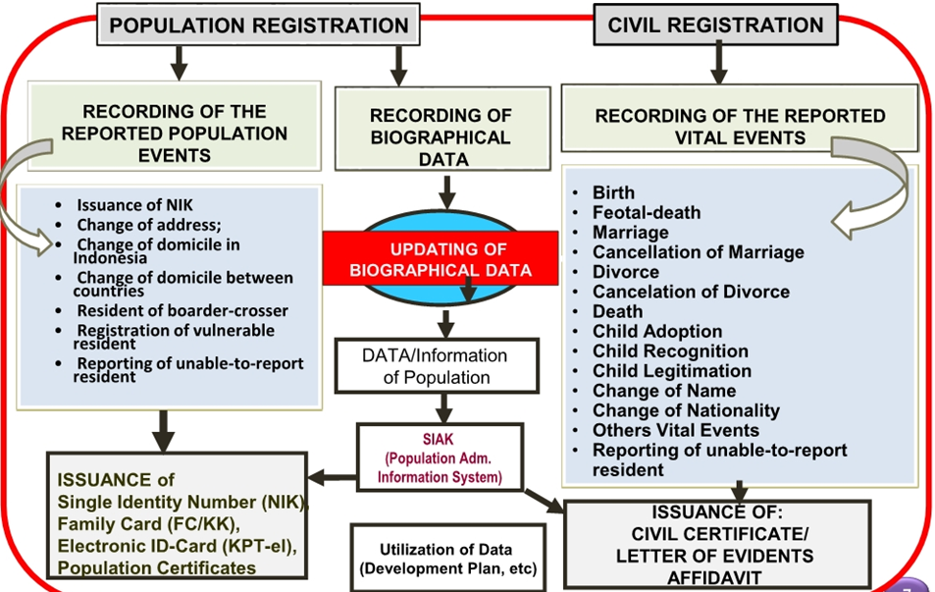
Population Administration Information System

Slide 14
Vital Statistics in Decentralization Era
(2001 - Now)
Civil registration in Indonesia conducted by the many stakeholders. In addition to the Civil Registration Offices, vital registration is also implemented by the Ministry of Health, DG Immigration, State Courts, Religious Courts and Religious Affairs Office (KUA).
MoH:
responsible for registration of vital events occurring in hospitals.
The State Courts, Ministry of Justice:
Responsible for vital events such as divorce for non Moslem citizens, child adoption, changes of name, changes of gender, and changes of citizenship.
DG of Civil Registration, MOHA:
Responsible for civil registration system in Indonesia
CRVS
Ministry of Foreign Ministry of Foreign Affairs:
Responsible for in-out migration of Indonesia conducted by the DG of Immigration
Ministry of Religion:
Responsible for registers marriages, divorces and reconciliations for the Moslem population
BPS-Statistics counting vital statistics from census/survey (complementing CRVS)

Slide 15
Coverage of CRVS and Population Administration
CRVS
Population Administration
1. Birth
2. Death
3. Marriage
4. Divorce
5. Adoption
6. Recognition of Child
7. Legitimation of Child
8. Changes of Nationality
9. Changes of Sex
10. Changes of Name
1. Biographical data recording
2. Maintenance of identity population
3. Migration
4. Registration of birth, death, still birth, marriage, divorce
5. Immigration (domicile status)

Slide 16
Obstacles for achieving complete coverage and for improving accuracy
Services tend to be passive, unreachable and complicated. In some districts, service providers are difficult to reach, application procedures are overly complicated.
Passive people report important events
Weak coordination and fragmented CRVS policies
Limited budget and capabilities

Slide 17
Obstacles for compiling vital statistics based on civil registration data as the main source
Lack coordination among implementing institutions
Lack of human resources
Difficulty in data integration
Geographical areas
Lack of socialization
Lack of awareness on the importance of civil registration
Incomplete population data to produce accurate vital statistics
Challenges faced with a decentralized reporting system

Slide 18
Efforts carried out or underway for assessing the quality of CRVS systems
Strengthening coordination and collaboration between relevant organization in using Population Data (SIAK) to increase public services based on SIN/Nik
Encourage innovation on IT-based services to all local governments offices (paradigm change → from manual based services to IT based services)
Capacity building for local governments officials
Expanding public services for all community without discrimination
Enhancing the awareness of community on the importance of civil registration certificates
Integrating SIAK services wih the religious affairs office at sub district (KUAC) for recording muslim marriage, SIAK with health services data (for birth and death), SIAK with social security data (Indonesia smart card, Indonesia health card with ownership of birth and death certificate

Slide 19
Measures taken to improve quality and interoperability of CRVS
Improving coordination among implementing institutions: sharing data, using same/standardized baseline, such as by creating a meeting forum and data integration system (data forum) to synchronize and disseminate data between all government offices.
Provide technical advisory services / training to assist regions with weak/dysfunctional/inadequate civil registration and vital statistics systems.
Facilitate the exchange of knowledge and good practices that ensure timeliness in the collection and compilation of civil registration records for statistical purposes.
Facilitate the exchange of good practices in improving registration in remote areas and among poorly covered subpopulations, as well as the registration of specific types of vital events.

Slide 20
Measures taken to improve quality and interoperability of CRVS (2)
Capacity building including dedicated training for budgeting, provision of certificates, data entry and management, and data usage.
Develop training materials and assist national training institutions in strengthening their capacity to deliver training on the skills and knowledge needed to improve the quality of vital statistics.
Provide training on guidelines and recommendations for the analysis, dissemination and use of vital statistics.
In terms of dissemination, regional government encouraged to deliver the data on the website to the public

Slide 21







Terima Kasih
Thank You
www.bps.go.id
Jl. Dr. Sutomo 6-8 Jakarta 10710
bpshq@bps.go.id
(021) 3841195, 3842508, 3810291
Badan Pusat Statistik (Page)
(021) 3857046
@bps_statistics

